Slide 1
Multi Year Public Relations Plan June 2020
PRM 2019-2020 – Lloyd Gwilliam DTM/PDIR

Slide 2
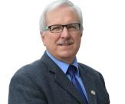
District 64 Toastmasters
Public Relations Manager 2019 - 2020
Videos since June 2018 for promotion & load YouTube channel content:
Special events (Fall Rally, TLI, Conventions)
District Meetings, #MyWhy & District announcements
Toastmasters Week
Thank you to Education Minister
Region Advisor Visits
Etc.
e-Newsletter since November 2018
Admin for Facebook Group & Facebook Page June 2019 to current
My past Multi Year Plans were more Fleet focused (CP & City of Calgary)
Trucks, Cars, Vans
Tractors, Mowers
Rail Equipment

Slide 3

What I hope to accomplish tonight:
Review of current status
General over view of the challenge
Tools/processes we currently utilize
7 or 8 step plan for Multi Year PR Plan
Gather some of your thoughts, opinions and ideas
(either tonight, or you sleep on it and provide)
Feel free to interrupt as we go along
I will be sharing this with District Leaders and our Region Advisors
www.JustHoller.com/multiyear

Slide 4
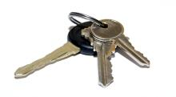

Typical PRM Year
July 1 – new year, keys to the car

Slide 5

Typical PRM Year
June 30 – can’t wait to move on

Slide 6

My opinion we need:
More methodical, organized approach
Multi year targeted approach to allow to build momentum year over year
Publicize tools to make roles/tasks
Easier
Repeatable
Consistent quality
Focused PR education
Easier transition
F.U.N. Job

Slide 7

Review
Current Situation
www.JustHoller.com/multiyear

Slide 8
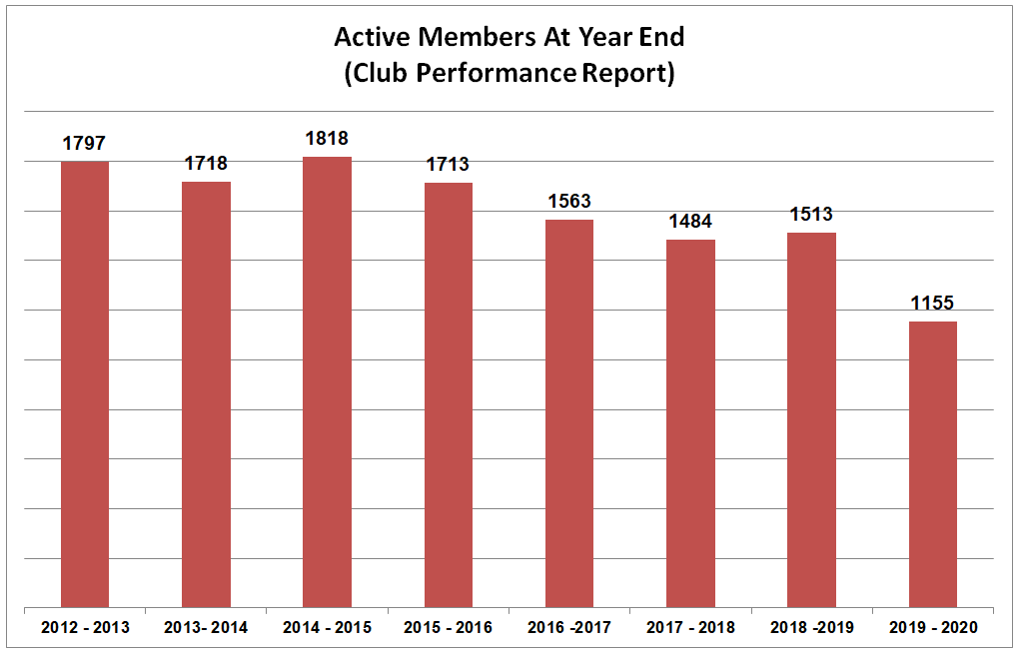
How Are We Doing - by the numbers?
Note: this year’s numbers are just till May 20, 2020

Slide 9
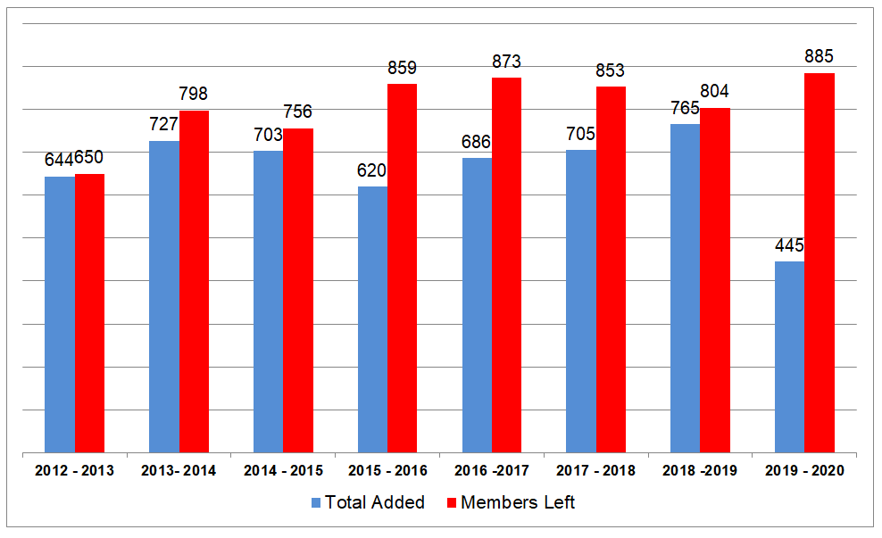
What is our retention like?
Excluding 2020 (7 years): 5,593 left and 4,850 joined diff of 743 (36 clubs)

Slide 10

Where do we focus our PR efforts?
Convince people to join?
Or stop them from leaving?

Slide 11
PR Goals (as per TI WHQ)
Generate positive awareness of the Toastmasters brand.
Keep the public (external audience) and members (internal audience) informed.
Good public relations will build membership, gain public recognition and help retain members.

Slide 12
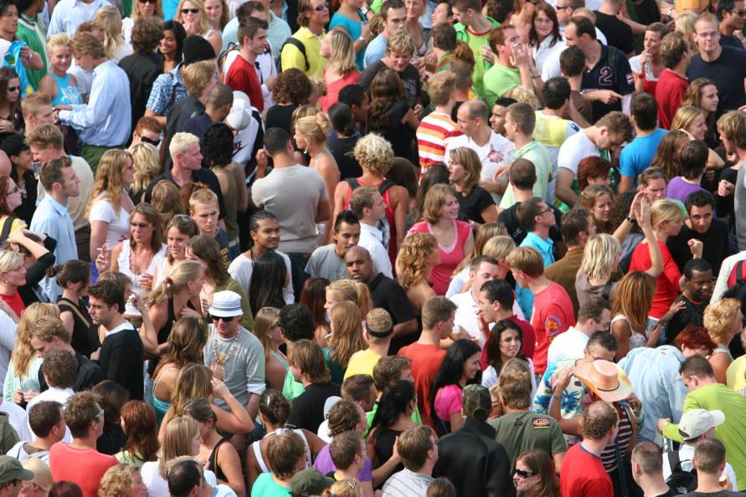
Sounds like everything for everyone

Slide 13

Hence the Multi Year PR Plan
Focused
Locally driven (D64)
ROI – effort vs $
Consistent “brand” promotion
Merge into a District wide strategy

Slide 14






Even while dealing with Identity/Brand slippage
Even as the Board is amending Policy 5.0 (Dec 18, 2019 Board Meeting)
1. The Toastmasters International Board of Directors may authorize the establishment of alliances between Toastmasters International and other organizations.
6. When Toastmasters International cooperates with other organizations, the separate identity of Toastmasters International must be maintained.

Slide 15
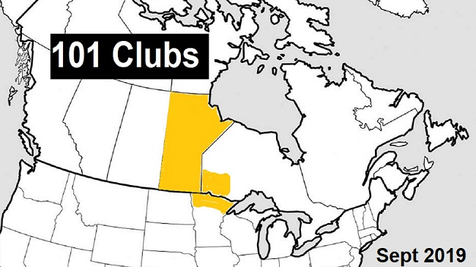

We need to focus on “who we are” within this organization

Slide 16



What do you like better?
1
2
3

Slide 17
PR distribution takes us in many directions
INTERNAL
Special events
Monthly meetings
News Items
Club Anniversaries
Contests
Contest results
e-Newsletter
Website
Blog
Facebook Group
Facebook Page
Twitter
Instagram
Linkedin
MeetUP
YouTube
EXTERNAL
Special events
Monthly meetings
News Items
Club Anniversaries
Contests
Contest results
e-Newsletter
Website
Blog
Facebook Group
Facebook Page
Twitter
Instagram
Linkedin
MeetUp
YouTube

Slide 18








APPS we could add to that extensive list ….
Pinterest
Snapchat
WhatsApp
WeChat
TikTok
And others…..But

Slide 19

But are we focused on where the fish are?

Slide 20

Facebook Group vs Page
FB GROUP
283 members
Members can post content
Cannot be “shared”
Well visited by members
Fairly established
FB PAGE
340 followers
Only Admin posts content
Anyone can comment
Can be “shared” to the world
Need more content and member sharing.

Slide 21

District Website vs Blog Site
WEBSITE
Mostly District business focused
“Join Us” page appears to be only item dedicated to public
BLOG
Mostly of interest to members
Full capacity not explored
Need content generators and more member sharing

Slide 22
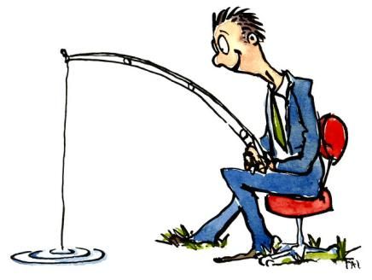


Meetup
Great tool for reaching out to external world
Not sure we are focused correctly
NEED – to develop District Strategy (1 vs many)
Twitter
Good tool for reaching out to external world
Can relay content from Toastmasters
Need local content as well
NEED - to market more to grow following

Slide 23
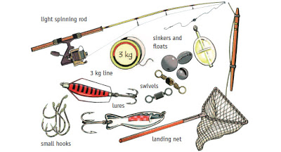
Traditional Media – involving “news releases”
TV
Radio
Newspaper, magazines
NEED - to develop larger list of contacts, build relationships over time

Slide 24
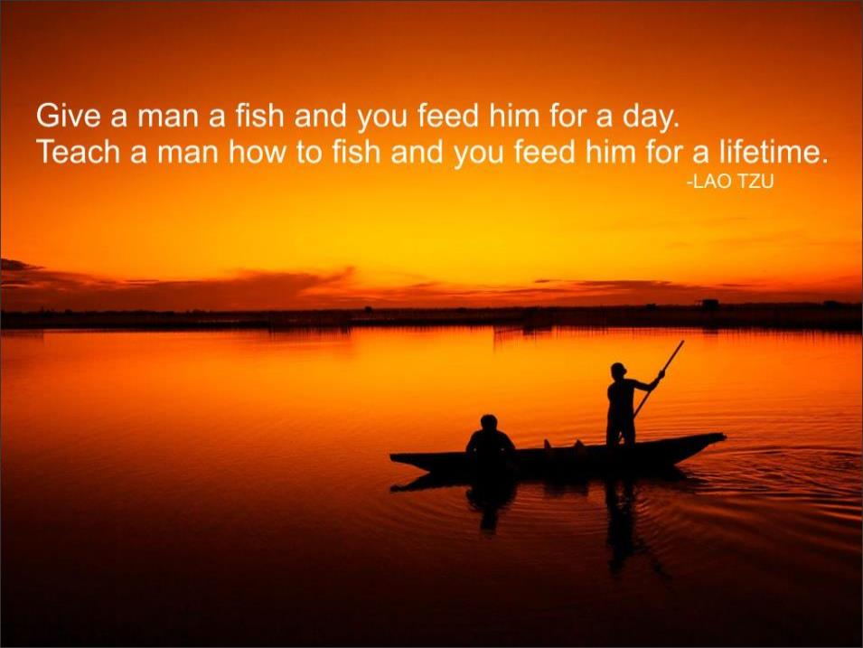

Slide 25


Where does our fishing boat take us?
PR efforts
The world
The Club
The members

Slide 26

Who What Where When Why How

Slide 27

Develop a simple Multi Year PR Plan
Know the product – brand awareness
Establish target market
Set some realistic goals
Develop strategies
Come up with “eye catchers”
Plan communications
Evaluate progress, refocus
Start all over again
Somewhere in there build a budget

Slide 28


1 - Know the product – brand awareness

Slide 29

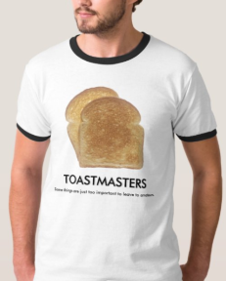


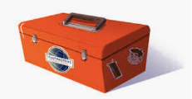
Brand Awareness ensures it meets TI specs. Check with them first!

Slide 30

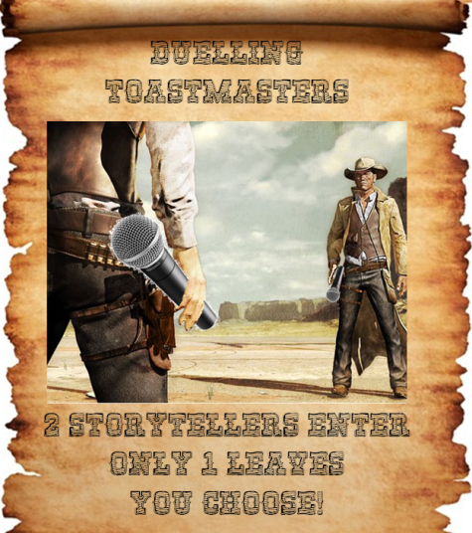



My first pitch was off target

Slide 31
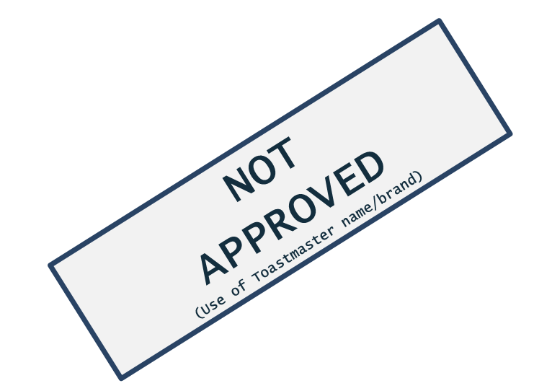
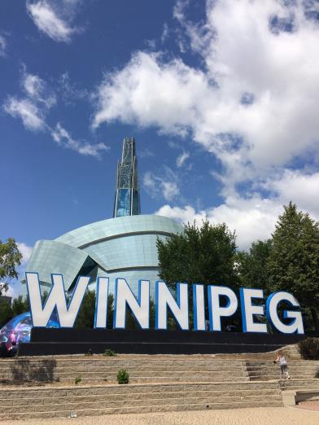

My second pitch also, but adjustable
Winnipeg
Community
Centres

Slide 32
2 - Establish target market
We have seniors locked up pretty well
For future growth – younger market?
CORPORATE
Business people
Working people
Upward mobile
COMMUNITY
Family members
Church members
Community Associations
EDUCATED
University students
College students
Government
MOTIVATED
Lifelong learners
Self Employed
CONNECTED
Influencers
Motivators
WHAT ELSE?
________________
________________

Slide 33

3 - Set realistic goals
5 new clubs
10% member growth
PR FOCUSED
2 Major campaigns
6 Medium sized campaigns
Twitter post every 3 days
Facebook post every 2 days
1 New Blog article per week
(Example only)
Specific
Measurable
Achievable
Relevant
Time Bound

Slide 34
4 - Develop strategies
We will declare the 3rd week in October “Toastmasters Week” every year
We will hold annual “Toasties” awards handed out at January TLI.
Events that capture media attention and peak the public’s interest in D64.

Slide 35
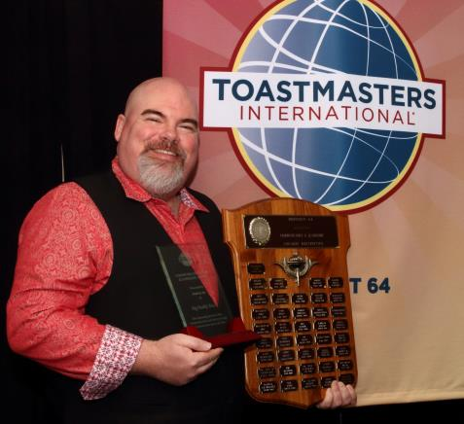
5 - Come up with “eye catchers”
Big Daddy Tazz
Receives District 64’s highest honor
Easy to promote
Media “may” pick up on it
Creates energy within
Have lead time to prep
Should be coordinated
Formula easily repeatable

Slide 36

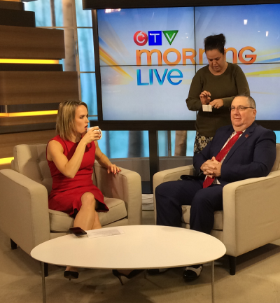
5 - Come up with “eye catchers”

Slide 37
6 - Plan communications
INTERNAL
e-Newsletter
Social Media
Club awareness
EXTERNAL
Media releases
Social Media
Develop relationships
Focus on -what to tell them, when to tell them and how to tell them. Develop a template that is easy to replicate.

Slide 38
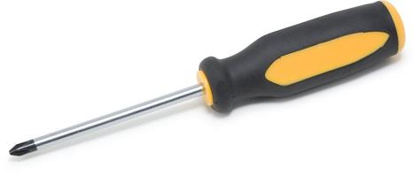
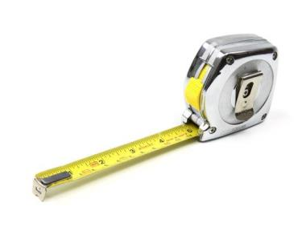
7 - Evaluate progress, refocus
Measure vs plan
Adjust if necessary

Slide 39

8 or 1 - Start all over again

Slide 40
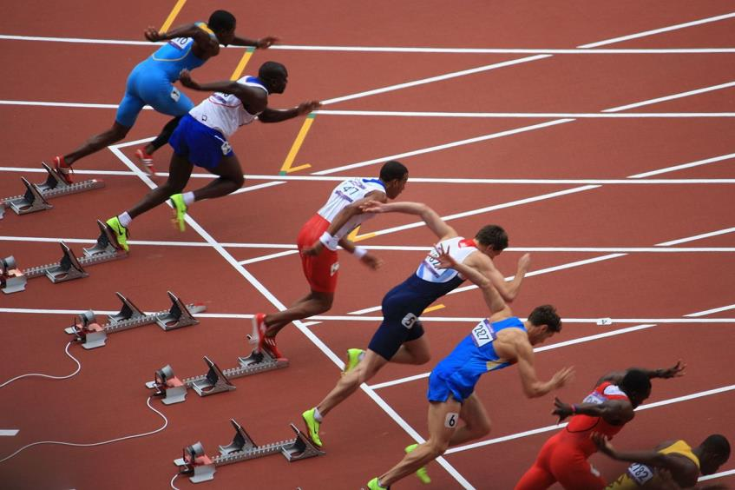
Don’t start over, continual growth process
Multi Year Plan!

Slide 41
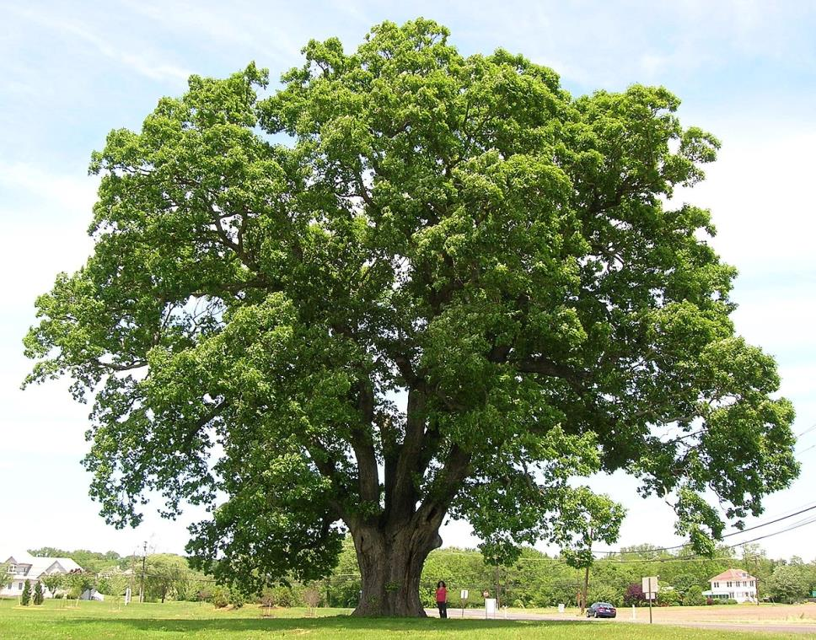
Continual Growth Process
Grow contacts & relationships
Grow consistency of events
Everyone starts to expect
Creates internal club energy
Build on successes

Slide 42
PR vs Advertising
Advertising costs money
Public Relations not so much – investment of time
Some advertising history:
Business Magazine Brandon - $500 in 2020
Rotary Career Symposium Winnipeg - $1.9k in 2020
Billboard Campaign Winnipeg – about $6k in 2016
Transit Campaign Winnipeg – about $6k in 2012

Slide 43
Paid Advertising
Needs to consider seasonal issues
Advertise in June – many clubs hibernate through summer
Advertise in November – people hibernate through holidays
Need to consider geography
Winnipeg advertising neglects rural
Need to consider Return on Investment (ROI)
Looking at membership numbers did you see spike?

Slide 44

Realistic things we could do:

Slide 45


2 Major Campaigns
Toastmasters Week in October
Start planning in May
Work on maximizing event
Div/Area/Club focused
PC Super Speakers/Pembina Valley
International Speech in Spring
Make it more public relatable
Promote the heck out of it
Secondary speech contest to support

Slide 46
Advertising Campaign
September to promote the upcoming Toastmasters Week in October
February to promote the upcoming International Speech season

Slide 47


Advertising Campaign
Toastmasters Week in October
I would put my main money here:
Has meaning for the public
Professional appeal
Relates to speaker and leader development

Slide 48
Eye Catchers or Media Attention Getters
Region Advisor Visits
Dignitary visits – President, Accredited Speakers,etc.
Mini Ted X – Jules & Young Professional TM
International Speech Contest – public focus?
Toastmasters Week
Youth Leadership expanded programming:
4 sessions
Offer opportunity to 12 High Schools
Pick 4 to receive the session

Slide 49

Tie it all into a master plan
1
Buy In From Trio
6
Train Clubs on Social Media
2
Full District Focus
5
Train Clubs on Media Releases
3
Solid Top Down Messaging
4
PR Webinars Monthly

Slide 50

My next steps?
Create draft Plan
Trio Feedback
Review at next Zoom meeting June 10
Adjust – present June 27
Publish for all to see

Slide 51

Wrap Up
What ideas caught your attention most?
Suggestions?

Slide 52


Homework – think a few days
Does you club have something to celebrate in the next few years?
Where do you go for PR resources?
Who is your club’s target market?

Slide 53


