Slide 1
Multi Year Public Relations Plan June 18, 2020
PRM 2019-2020 – Lloyd Gwilliam DTM/PDIR

Slide 2

90% PR effort
Lands on internal audience.
Notes:
From my experience the Public Relations in District 64 has a small focus on external relations. This can be modified with a good multi-year plan that focuses some resources in toward the general public.

Slide 3

Our events lack public interest (WIIIFM)
Fall Rally
Fall TLI
January TLI
Monthly hotel District Meetings
Speech Contests
Spring Convention
Notes:
Fall rally – for members to get ramped up in September. If it is held 2nd or 3rd week in September we are already at the end of quarter 1 before we launch anything.
Fall TLI – is focused more for the membership. It does include some education sessions that might be of interest to the public, if promoted alone, however the event is a day for the members.
January TLI – similar to Fall TLI but includes some Club Officer Training at that time of the year.
Monthly Hotel District Meetings – totally member related. However, of the 1200 or so members typically the same 40 show up with a variety of 20 or so other folks. A lot of cash is spent on these sessions with very little support to non-attendees.
Speech Contests – more related to clubs and advancing skills.
Spring Convention – member focused. Annual General Meeting, Annual Awards, Speech Contests, etc. Very little general public interest.

Slide 4
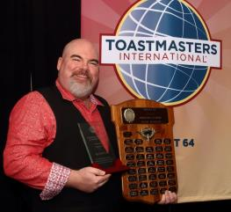
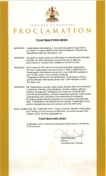
Some exceptions
Communication and Leadership Award
Toastmaster Week Proclamation
Notes:
We did have proclamations the past 2 years at the Provincial Level. Last year I expanded that to several communities. The City of Winnipeg does not do proclamations. We could do Toastmasters Week with, or without, proclamations. I do believe the previous time we took advantage of proclamations was in 2012.
Communication and Leadership Award – is given to a community member. This can have public appeal, however not sure how we promote that as they tend to keep the recipient quiet until award time. Even so if we knew a month ahead could we turn that into a public attended event? That might do something for brand awareness but our goal is to get guests out to our clubs.

Slide 5













PR tool kit is huge but weak on outward vision
Notes:
Just a list of public relations tools that we have at our disposal. There are more we could take on but making quality use of these ones is still an outstanding goal.

Slide 6

Why a Multi-Year Public Relations Plan?
(Build some outward focus)
Goal 1 - Grow the membership
Build brand awareness with the public
Goal 2 - Reduce impact of July 1st transition
Consistent campaigns year over year
Keep momentum rolling
Notes:
I believe we need a methodical organized approach to growing the brand within our community. With campaigns consistent year over year the clubs know what to expect, when to expect it and can be prepared to maximize any public relations efforts needed. We need to keep that momentum rolling. With a July 1 turnover it is too easy to drop the ball June 30 and hope that someone will pick it up on July 1. As a majority of our clubs tend to take the summer months off we don’t regain momentum until after the Fall Rally in mid September.

Slide 7


Goal 1 – Grow the Membership
(Building Brand Awareness)
Provide Clubs with PR campaigns, resources & support to capture public attention
Dedicate funds to targeted annual advertising campaigns
Respect geographic considerations ($$)
Timed for maximum ROI/Effort
Notes:
Funds come from members and are limited. We need to be sure we plan to spend them wisely trying to get the most bang for the buck. Not only is it money but it could be effort – hours of volunteer work to get some of these programs moving.
The geographic consideration is to ensure we do something for rural clubs. We could look at a percentage formula. While 80% would be spent in the city of Winnipeg we could do some smaller ads in smaller papers around rural communities. Easy enough to make a budget division spreadsheet for that. We might even be able to do a matching contribution – we match club output.
Match timing – we should spend any large advertising dollars in September and October. Spending in June is unproductive as clubs hibernate through the summer. Spending in November is unproductive as people hibernate through the holidays. However, spending in January thru March could have a good impact. Depends on what we are selling? TM Brand and name – could do. Open houses, special meetings? Maybe.

Slide 8
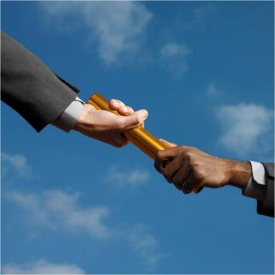
Goal 2 - Reduce impact of July 1st transition
Forecast programs year over year
Plan campaigns well in advance
Develop & share easily replicable tools/resources
Ready to roll in June rather then late September.
Notes:
We need to create a toolbox with all the tools clubs need to promote themselves. Media releases tailored to D64. Proclamation requests tailored to D64. Fliers, promotional documents, etc. Have them on a resource site on our website.
They start to become like the Fall Rally – expected every year, clubs ready to take on. Problem with Fall Rally is it focuses inward, nothing for the general public. The other problem is that the waiting till the Fall Rally sees a 2 month lag. At the very least we have to be ready end of August, start of September.

Slide 9

Develop a simple Multi-Year PR Plan
Know the product – brand awareness
Establish target market
Set some realistic goals
Develop strategies
Come up with “eye catchers”
Plan communications
Evaluate progress, refocus
Start all over again
Notes:
Just my 7 or 8 step plan followed to think through this process. Item # 6 is the communication plan that TI wants the PRM to provide each year. Depending on focus could have more or less steps.

Slide 10

Public Relations Campaigns
2 Major/Medium Campaigns per year
Create public interest (WIIIFM)
Major District effort, club supported
4 Minor Campaigns per year
Occur at Club Level (their market)
Open houses, special meetings, etc.
Club effort, District supported
Notes:
Our campaigns must to have a public interest draw to them. They need to see “What is in it for me?” Even the club based programs must have a public draw to them.
Come out to our club this week for this themed event – Interview Skills, Impromptu Speaking, Etc.

Slide 11

ALL Campaigns need:
To be planned well in advance
An ability to attract public interest
To catch the eye of media
Notes:
To attract media attention, in that they would publish something, there has to be something in the pitch for the public. Why do they want to hear about this? Our campaigns should be the answer to that question. We need to catch their eye, their ear, their attention. Some examples – a club that has an open house based around “nailing a job interview” that would happen in March or April before University students leave for the summer. Could also be “Better speaking New Years resolution.”

Slide 12


2 Major/Medium Campaigns
Toastmasters’ Week in October
Work on maximizing events
Culminates with fall TLI
M a j o r
M e d i u m
International Speech in Spring
Make it more public relatable
Notes:
Toastmasters week can be full of anything the club can imagine. Themed meeting, open houses, educational sessions, guest meetings, interview tips, meeting tips. The District needs to warehouse some effective ideas to help clubs work though these. The week would end with the Fall TLI – sadly enough the end of the week is of little interest to the public however it can get the membership pumped up, energized and aware. The public payoff is in the club’s events during the week.
International Speech as a public eye catcher – not as effective as Toastmasters week but maybe with the right sales pitch it could catch media attention.

Slide 13
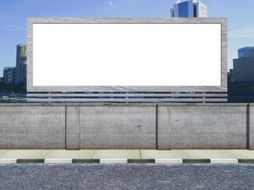
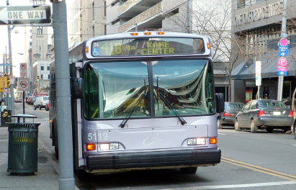

Paid Advertising – some history
Business Magazine Brandon - $500 in 2020
Rotary Career Symposium Winnipeg - $1.9k in 2020
Billboard Campaign Winnipeg – about $6.5k in 2016
Transit Campaign Winnipeg – about $6.5k in 2012
Notes:
Again, if spending money they need to be at the right time. For instance one shouldn’t do an ad campaign in June as the clubs go into hibernation for the summer. And a campaign in late November or early December hits a public that is going into hibernation around the holidays. Plus clubs close for a few weeks around Christmas and New Year. Better timing would be September as our clubs ramp up, or January through March.

Slide 14

What can we dedicate consistently to a budget? To build brand during 1 Major Campaign
Notes:
Can we devote $6,500 to an advertising campaign each year?
$5,000 for a digital billboard campaign in Winnipeg, $1,500 to rural concerns?

Slide 15
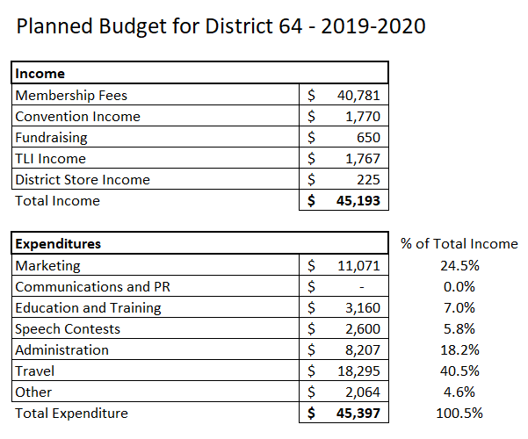

Slide 16
Some things I saw over time
March 2017
$12,000 underspent
Cash reserve grew from $14,000 from $38,000 in 2014
May 2019
$8,000 underspent
June 2020?
Marketing had an $11,071 budget this year
Notes:
Just some observations of budget reports over the past few years. I notice we never see a year end report?
TI guidelines:
Education and Training – 30%
Communications and PR – 25%
Speech Contests – 10%
Administration – 20%
Travel – 30%
Other 10%
Marketing – no limit

Slide 17

Major AD expenditure timing
September thru October?
Clubs back in action from summer break
Everyone fresh to get rolling
January thru March?
New Year energy
Clubs striving to finish successfully
Another time?
Notes:
The two major campaigns for the Bus and Billboards ran in different time slots. One ran in May/June and the other ran in September – November. The advertising people say splitting the money between two time slots is not as effective as spending in one time slot. So we could do Sept/Oct one year, then February/March another year, then back. As long as we have something to sell.

Slide 18

4 Minor Campaigns (Club based) (Challenge clubs to do 2 or 3 minimum)
September – some type of “Back to School”
December/January - New Year Resolutions
February/March – Talk Up Toastmasters
May/June – Beat The Clock
Notes:
These are just some suggested events. We could do an inventory – plan out some time lines and give them a whirl. Evaluate at the end of the year to see if we need to adjust. Not every club has to take in every event.

Slide 19

Tie it all into a master plan
1
Launched by the Trio
6
Train Clubs on Social Media
2
Full District Focus
5
Train Clubs on Media Releases
3
Solid Top Down Messaging
4
PR Webinars Monthly
Notes:
The steps to support this plan. Top down messaging is the same message from everyone.
PR Webinars – to help educate anyone on the next program, needs, reasons, tools, etc.
Train clubs on how to manage media releases, give them examples – offer the Zoom training and work with whoever comes on.
Same for social media. We need to bring use of the tools into the 21st century.

Slide 20
Other Initiatives – Youth Outreach (District Focus – this is our future)
Expanded Youth Leadership sessions
Contact more schools
Larger campaign
Stronger presence in Universities
Liaison person dedicated to promote
D64 volunteer to pilot new TI program
Notes:
This is a totally separate initiative. Our District is very senior based. As they age out we need new membership. Shifting some attention to youth outreach could pay off in 5 to 10 years down the road.

Slide 21
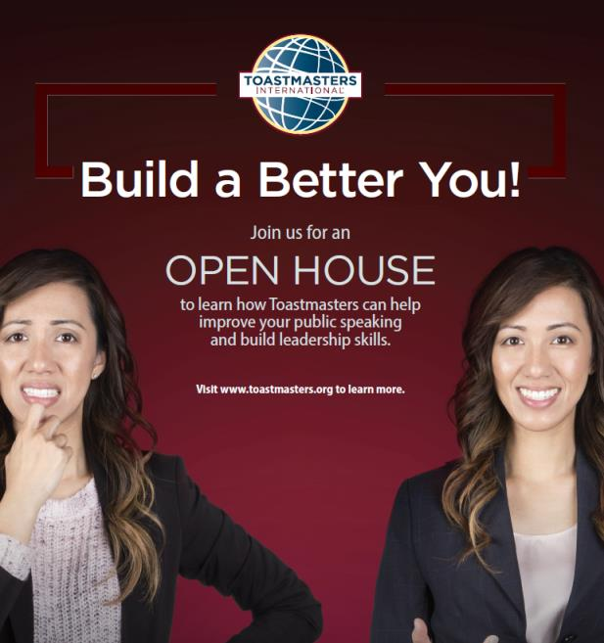
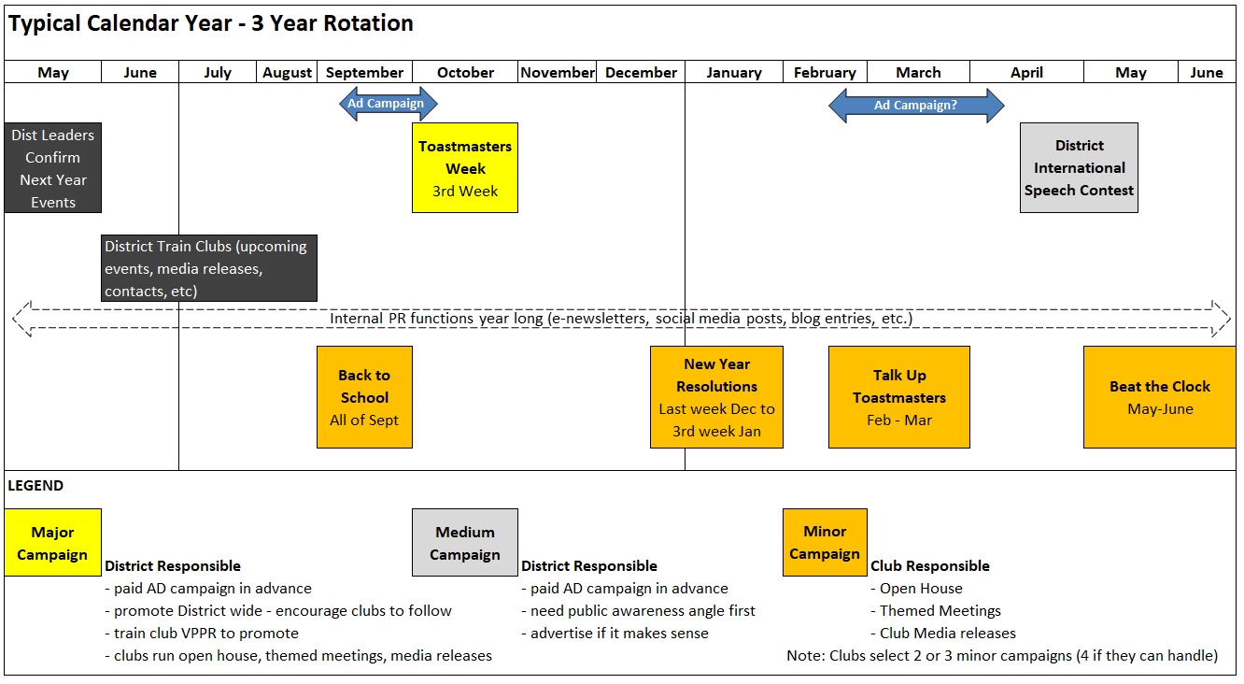

Slide 22


Things that need to happen
PR Training for Clubs
Find their local media outlet
How to do Media Release
How to utilize social media
Ideas for themed “eye catching” meetings
Create resource templates, store on website
Media release templates
Media contacts throughout D64
Flier and poster templates
Themed meeting suggestions
Proclamation requests templates
Ad Budgeting forecast tool
Notes:
Just a short list of some things that would have to happen or be put in place. Would be nice to have lined up sooner then later but it is a multi-year plan so can be updated, revised or added to as time goes forward. Create and improve.

Slide 23
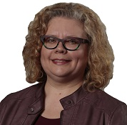
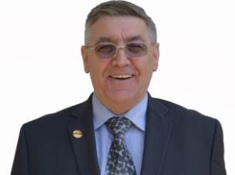
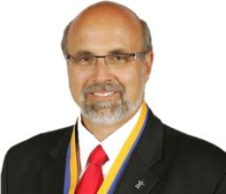
What we need from the District Leadership?
Adopt the plan (adjust if needed)
Support a consistent PR ad campaign budget
Implement the plan
Review/adapt yearly
District 64 Leadership
Notes:
The million dollar question – can the team support this approach? Support the programs? With a rolling 3 year consistency it might be possible. My major goal would be to earmark some funds for an outside ad campaign.

Slide 24
How do we succeed?
Adopt the (a) plan – when/how?
Communicate the plan
Everyone works to same goals
Notes:
Can we go ahead with such plan? Adoption calendar?

